Slide 1


Swiss Travel System Excellence Program.

Slide 2

The most important in brief.
The interactive e-learning program:
Heidi & Peter take you on a learning journey across the Swiss Travel System
Familiarize yourself with the modes of public transport and win attractive prizes
This allows you year after year to playfully broaden your public transport knowledge and support your clients in a professional and competent manner.

Slide 3

The most important in brief
Learning is made easy and fast with a modular structure
The program is web-based and accessible from anywhere in the world at any time
Available languages: German, English and Chinese Simplified
Launch: spring 2021
Jump on the bandwagon and register now: mystsnet.com/elearning

Slide 4

Contents.
It is the only e-learning program worldwide that maps the entire public transport system of a country
It is organized in several courses (Basics, Advanced, Expert, News) with a total of more than 20 modules. These range from premium panoramic trains to tickets and passes to services at the train station
Your level of knowledge will be tested at the end of each course
After successfully completing the tests, you will become “Swiss Travel System Excellence Expert” and receive a diploma.

Slide 5




4 reasons why you should register:
You experience a modern and entertaining e-learning program.
You participate in periodic raffles and can win attractive prizes.
You bring your know-how up to date year after year.
You become a “Swiss Travel System Excellence Expert” – free of charge.

Slide 6




How it works.
Sign up
Step aboard the Swiss Travel System Excellence Program.
Start learning
Select a module of your choice and begin your learning journey.
Check your current progress
Take tests and compare your current learning score to that of other participants.
Get rewarded
Receive the diploma as “Swiss Travel System Excellence Expert”! On top of that, you can win attractive prizes.

Slide 7
Added value for your agents. (Slide Systempartner)
The e-learning program holds many advantages for the associates of your distribution network:
Through the targeted training, they learn everything they need to know about Swiss public transport
They are able to support their clients competently and confidently
They know which public transport products are best suited for the travel programs
The STS Excellence Program motivates, raises awareness, and stimulates increased sales on the Swiss Travel System
It reduces training costs

Slide 8
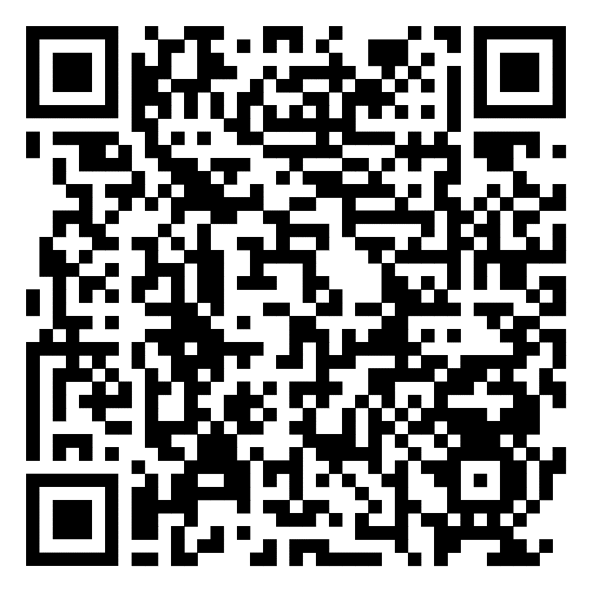
Join Heidi & Peter and start your learning journey.

